Slide 1
Project C.A.S.P.
Week 10, 4/10/17
Ryan Tedeschi
Dylan Carson
Chris Bowlen

Slide 2
Weekly Progress
Outline Module completed
Standalone Implementation ready
Need to create individual module implementations
Minimal work remaining for Analyze Module
Code cleanup and functionality tweaking
Communication between core module and submodules updated
Program output changed – Returning JSON-like structure

Slide 3
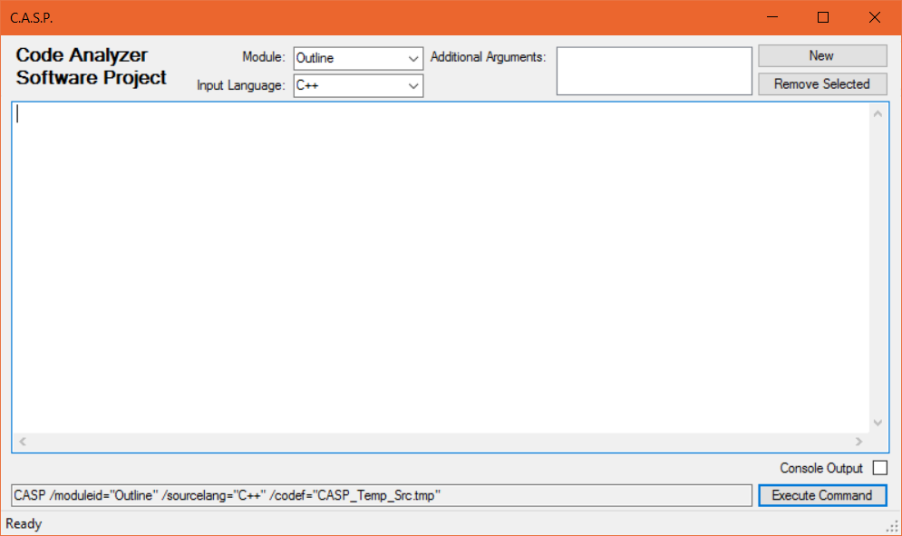
Standalone Implementation
Puts a UI to the program’s input
Module selection
Input Language selection
Additional Arguments
Able to view raw console output
Preview of executed command
Saves source code to a temporary file

Slide 4
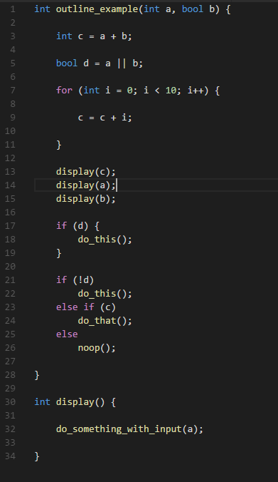
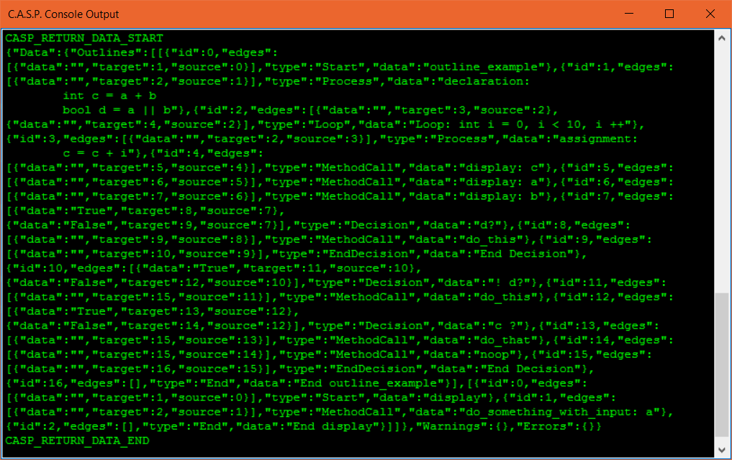
Outline Module: Flowchart

Slide 5
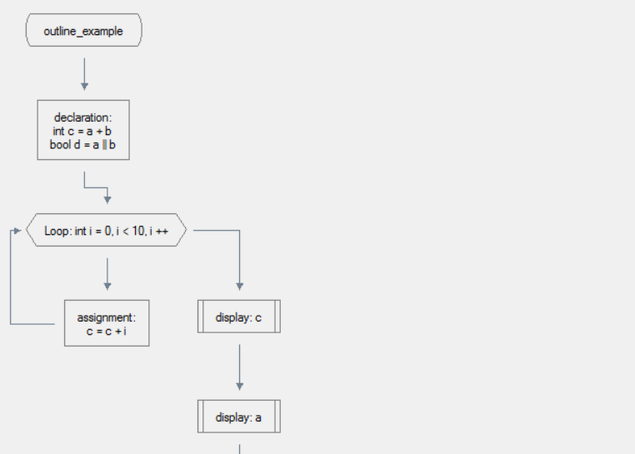
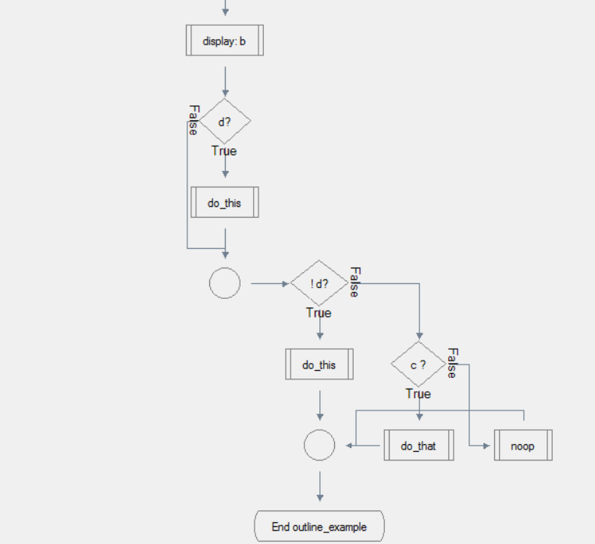
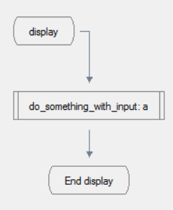
Outline Module

Slide 6
Weekly Tasks
Ryan
Work on Translate Module
Complete logic for Analyze Module in standalone implementation upon Dylan’s completion
Cleanup and functionality tweaking, bug fixes, documentation
Dylan
Complete Analyze Module
Transition to Translate module upon completion
Chris
Translate Module

